Slide 1

Peritonsillar Abscess Drainage

Slide 7
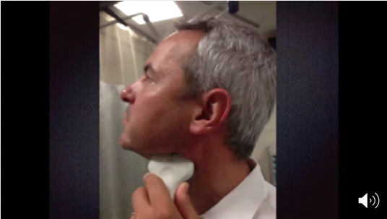

Slide 8
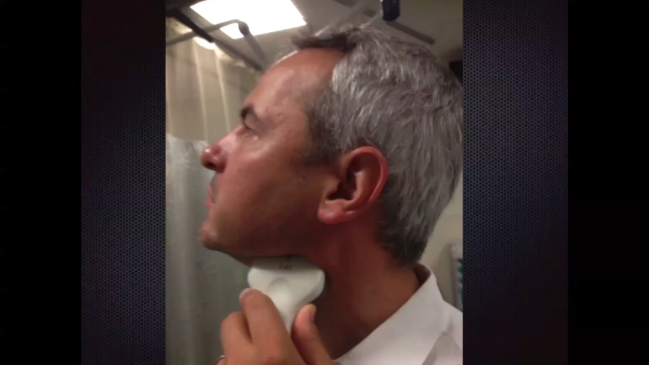

Slide 9
Bleeding
Management

